Slide 1
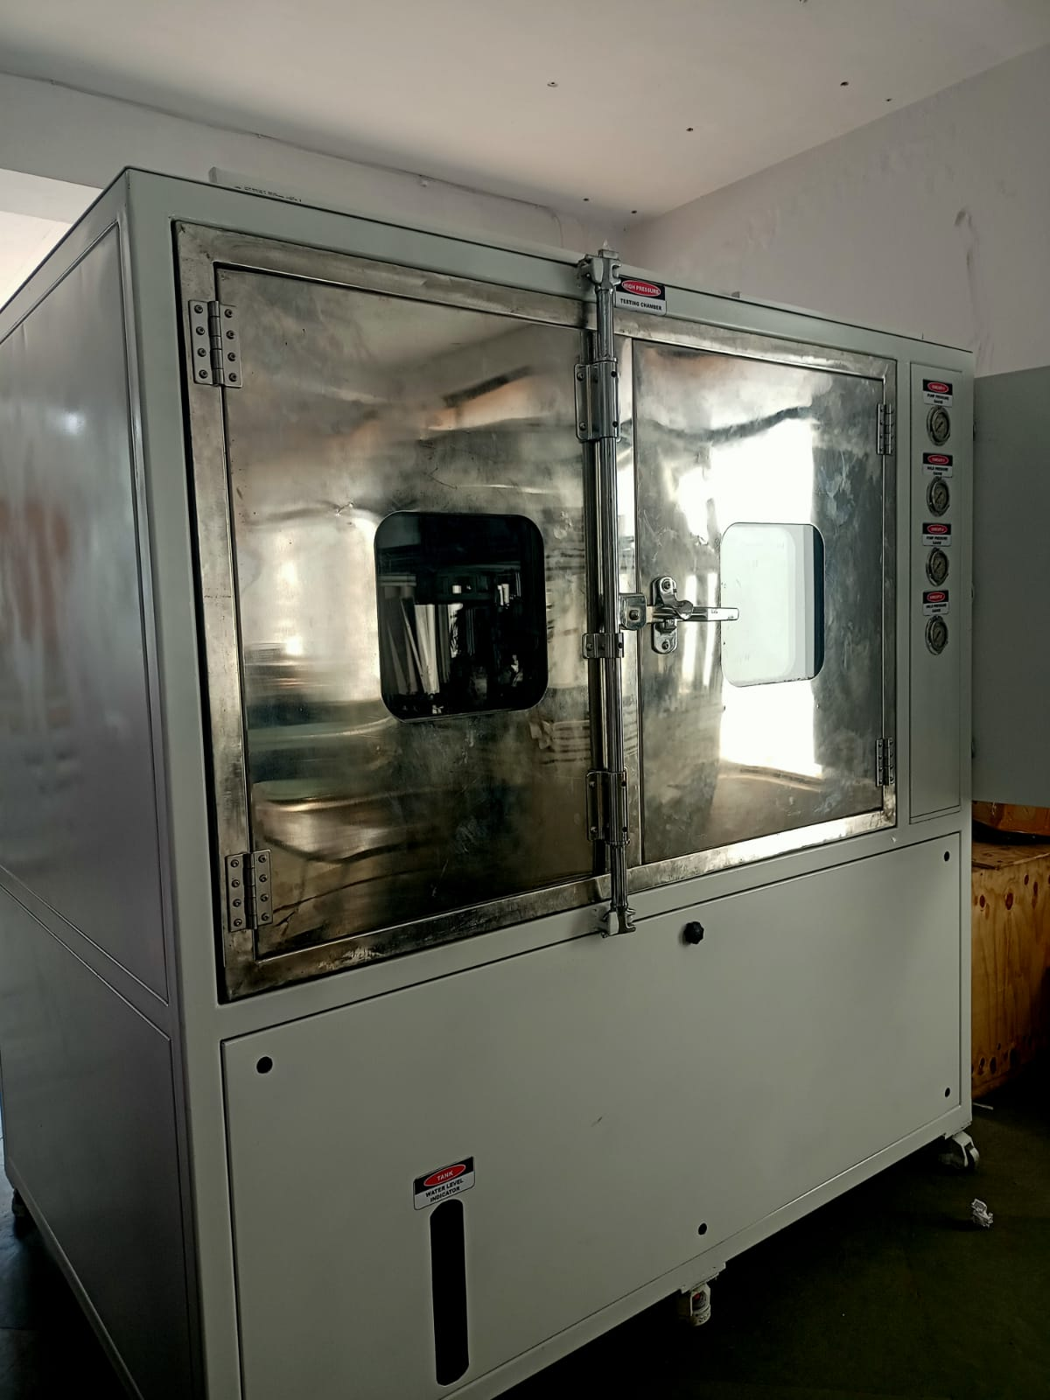
Pressure Cyclic & Burst Test Machine

Slide 2
**Parameter** | **Specification**
Machine Type | Pressure Cyclic & Burst Test Machine
Pressure Range | 0 to 500 bar (customizable)
Test Types | Cyclic Pressure Test <br> - Burst Pressure Test
Pump Type | High-Pressure Electric Motor Pump / Hydraulic Intensifier
Test Medium | Clean Water / Oil / Glycol Mix
Pressure Control | Electronically Controlled via PLC
Pressure Accuracy | ±0.5% Full Scale
Cycle Pattern | Programmable (Square / Ramp / Custom Profile)
Max No. of Cycles | Up to 1 million cycles (based on design)
Data Recording | Real-Time Pressure vs. Time / Cycle Graph
Display & Control | 7" or 10" Color Touchscreen HMI
Data Storage / Export | USB / Ethernet / SD Card / Excel Report (CSV, PDF)
Pressure Transducer | SS316, High Accuracy, 4–20 mA Output
Sample Clamping Fixture | Customizable Manual or Pneumatic Clamp
Burst Detection | Automatic Shutoff on Sudden Pressure Drop / Optional Sensors
Safety Features | (1)Pressure Relief Valve (2)Emergency Stop (3)Door Interlock

Slide 3
Test Chamber (optional) | Transparent Safety Enclosure (Polycarbonate / MS with Window)
Power Supply | 3 Phase, 415V AC, 50/60 Hz
Machine Frame | MS Powder Coated or SS304 Frame
Software (optional) | PC-based control & report generation
Compliance | As per ISO 1402, SAE J343, ASTM D380, or customer requirement
Optional Features
Temperature control system (for medium)
Automatic test scheduling
Dual-station (two samples simultaneously)
Remote monitoring via IoT/GSM
Use Case Examples
Hose Testing (Hydraulic, Automotive)
Tube/pipe pressure rating
Valve integrity testing
Component burst failure analysis

