Slide 1
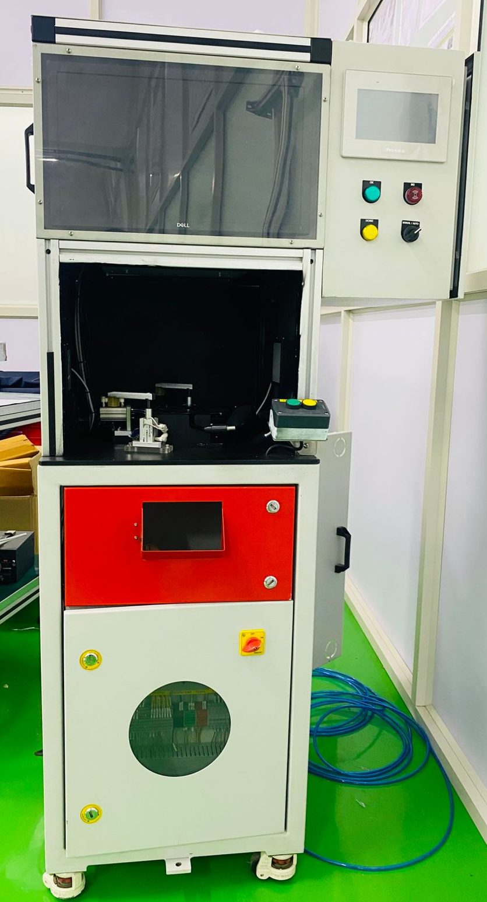
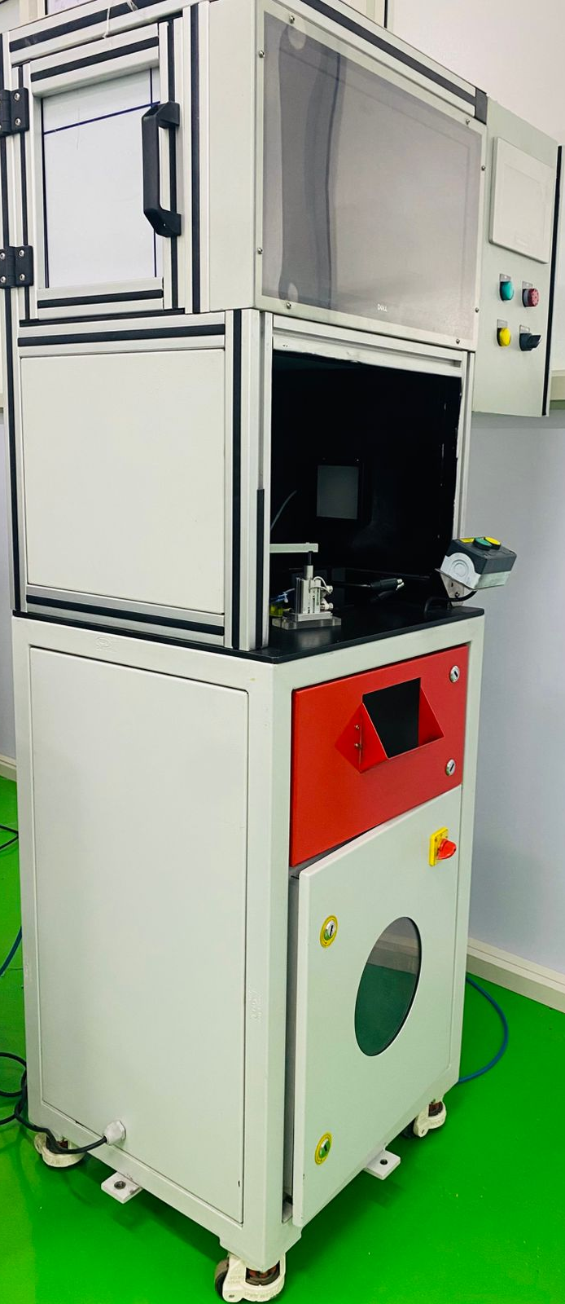
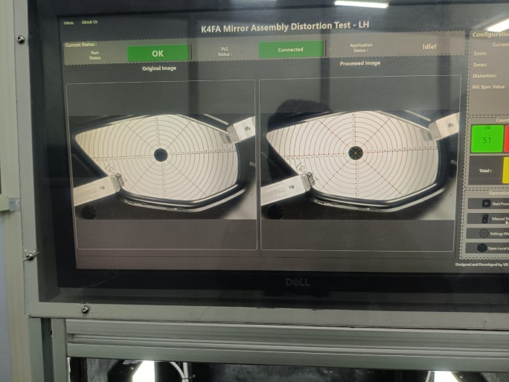
Mirror Distortion Testing Machine (Vision inspection)
Screen

Slide 2
This project, "Mirror Distortion Testing (Vision Inspection)," is an automated quality control system designed to detect and measure distortions in mirrors. It leverages computer vision and PLC communication to ensure that manufactured mirrors meet specified quality standards.
Automated Precision Inspection:
Our system utilizes advanced computer vision algorithms to automatically detect and quantify distortions in mirrors. This eliminates the subjectivity and inconsistencies of manual inspection, leading to superior quality control
How it Works
The system captures high-resolution images of the mirror, then intelligently identifies and analyzes specific "nodes" (points of interest) on its surface. By precisely measuring the distances between these nodes and the mirror's true center, it calculates even the most subtle distortions
Real-time Distortion Analysis
The system provides immediate feedback on mirror quality, categorizing parts as "OK" or "NG" (Not Good) based on pre-defined tolerance thresholds. This real-time analysis allows for immediate corrective action in the manufacturing process

Slide 3
Technical Insight
Distortion is calculated by analyzing the maximum and minimum deviations of detected nodes from their expected positions relative to the mirror's center. This is expressed as a percentage, providing a clear and quantifiable measure of quality.
Seamless PLC Integration
Designed for industrial environments, our system communicates directly with Programmable Logic Controllers (PLCs). This enables automated part handling, status reporting, and command execution, ensuring a fully integrated and efficient production line
Benefits
This integration streamlines the manufacturing workflow, reduces human intervention, and enhances overall operational efficiency.
Intuitive User Interface & Calibration
The system features a user-friendly graphical interface built with PySide6, allowing operators to easily monitor inspection results, access historical data, and manage system settings.

Slide 4
Smart Calibration Workflow
A guided calibration process ensures accurate measurements. Operators first scan a known "OK" master part, followed by an "NG" master part. This establishes the acceptable range of distortion, making the system robust and reliable.
Comprehensive Data Logging & Reporting
All inspection data, including timestamps, distortion values, and pass/fail status, is meticulously logged in a secure SQLite database.
Actionable Insights: This data can be easily exported to Excel for in-depth analysis, trend monitoring, and compliance reporting, providing valuable insights for continuous process improvement.
Flexible Camera Control
Operators have granular control over camera settings such as zoom, pan, brightness, and sharpness, allowing for optimal image capture tailored to specific mirror types and inspection requirements.
Pylon Camera Integration
The system leverages the powerful Pylon API for Basler cameras, ensuring high-performance image acquisition and reliable camera management.

